Slide 1
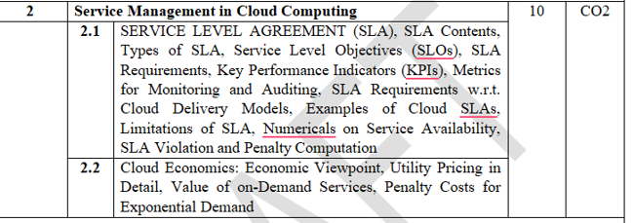
Module 2: Service Management in Cloud computing

Slide 2
Service Level Agreement
SLA:
Cloud computing provides IT resources such as servers, storage, databases, networking, and software over the Internet.
Since these services are offered by cloud providers like AWS, Microsoft Azure, and Google Cloud, customers expect these services to be reliable and always available.
To ensure that the provider delivers the promised quality of service, a formal agreement called a Service Level Agreement (SLA) is established.
An SLA defines what services will be provided, the expected performance, availability, responsibilities of both parties, and the penalties if the provider fails to meet the agreed service standards.

Slide 3
Service Level Agreement
Definition
A Service Level Agreement (SLA) is a formal contract between a cloud service provider and the customer that specifies the quality, availability, responsibilities, and performance standards of the cloud service.
It ensures that both parties clearly understand their obligations.
Example
Amazon Web Services promises 99.99% uptime for Amazon EC2 instances. If AWS fails to meet this availability, customers receive service credits according to the SLA.

Slide 4
Service Level Agreement
Why is SLA Required?
Organizations store important applications and sensitive data in the cloud. Any service interruption may result in financial losses or business disruption.
An SLA helps by:
Clearly defining service expectations.
Guaranteeing service availability.
Measuring service quality.
Building trust between the provider and customer.
Protecting customer interests.
Providing compensation if service quality is not maintained.

Slide 5
Service Level Agreement
Objectives of SLA
The main objectives are:
Guarantee service availability.
Ensure high performance.
Improve customer satisfaction.
Define responsibilities.
Establish measurable service standards.
Reduce misunderstandings.
Improve service monitoring.

Slide 6
Service Level Agreement
Importance of SLA
An SLA is important because it:
Defines measurable service quality.
Helps monitor provider performance.
Improves accountability.
Provides legal protection.
Enables performance auditing.
Ensures continuous service improvement.

Slide 7
Service Level Agreement
Characteristics of a Good SLA
1. Clearly Defined
The agreement should clearly explain the services provided.
2. Measurable
Performance should be measurable using metrics such as uptime, latency, and response time.
3. Realistic
The promised performance should be achievable.
4. Flexible
The agreement should allow modifications when business needs change.
5. Enforceable
There should be legal provisions for handling violations.

Slide 8
Service Level Agreement
Parties Involved in SLA
There are mainly two parties.
Cloud Service Provider
Examples: Amazon Web Services (AWS),Microsoft Azure,Google Cloud Platform (GCP)
Responsibilities include:
Providing cloud services,Maintaining infrastructure,Monitoring services,Meeting agreed performance.
Customer
Responsibilities include:
Paying subscription fees,Properly using cloud services,Following security guidelines,Reporting service issues.

Slide 9
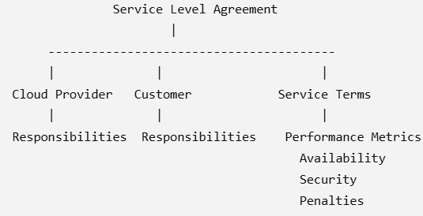
Service Level Agreement
Basic Structure of SLA

Slide 10
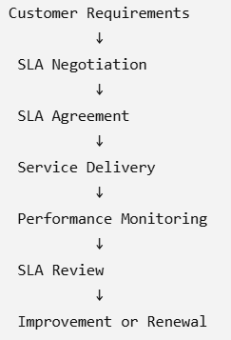
Service Level Agreement
Life Cycle of SLA:

Slide 11
Service Level Agreement
Benefits of SLA:
For Customers
Guaranteed service quality
High availability
Better transparency
Reduced business risk
Compensation during failures
For Providers
Improved customer trust
Better service management
Competitive advantage
Performance monitoring
Increased customer satisfaction

Slide 12
Service Level Agreement
Real-Life Example
Suppose a bank hosts its online banking application on Microsoft Azure.
The SLA states:
Availability = 99.95%
Response Time = < 200 ms
Daily Backup
Recovery Time = 30 minutes
If Azure fails to maintain 99.95% uptime, the bank receives service credits according to the agreement.

Slide 13
Service Level Agreement
Advantages of SLA
Improves service quality
Defines responsibilities
Reduces conflicts
Increases customer confidence
Provides measurable performance
Supports continuous monitoring

Slide 14
Service Level Agreement
Advantages of SLA
1. Improves Service Quality
An SLA defines the minimum level of service that the cloud provider must deliver.
It includes performance standards such as uptime, response time, availability, and reliability.
Since providers are contractually obligated to meet these standards, they continuously improve their infrastructure and services.
Regular monitoring ensures that services remain consistent and efficient.
Example:
If an SLA guarantees 99.99% availability, the provider must ensure the service remains operational with minimal downtime.

Slide 15
Service Level Agreement
Advantages of SLA
2. Defines Responsibilities
An SLA clearly specifies the responsibilities of both the cloud service provider and the customer.
It removes confusion by stating who is responsible for:
Data backup
Security
System maintenance
Software updates
Disaster recovery
Technical support
Clearly defined roles reduce misunderstandings.
Example: In an Infrastructure as a Service (IaaS) model:
Provider manages hardware, networking, and virtualization.
Customer manages operating system, applications, and data.

Slide 16
Service Level Agreement
Advantages of SLA
3. Reduces Conflicts
Since expectations are documented in writing, disagreements between customers and providers are minimized.
If service issues occur, both parties can refer to the SLA for resolution.
The SLA provides a legal framework for handling disputes and service failures.
Example:
If the provider fails to meet the promised uptime, the SLA may specify compensation or service credits, avoiding lengthy disputes.

Slide 17
Service Level Agreement
Advantages of SLA
4. Increases Customer Confidence
Customers know exactly what level of service they will receive.
Transparency builds trust between the provider and customer.
Businesses feel more confident migrating important applications and data to the cloud.
Customers can compare different providers based on their SLA commitments.
Example:
A company choosing between two cloud providers may select the one offering:
Higher availability
Faster response times
Better support guarantees

Slide 18
Service Level Agreement
Advantages of SLA
5. Provides Measurable Performance
SLAs define measurable performance metrics called Key Performance Indicators (KPIs).
These metrics help determine whether the provider is meeting the agreed standards.

Slide 19
Service Level Agreement
Advantages of SLA
5. Provides Measurable Performance
Common SLA metrics include:
Service Availability
Response Time
Recovery Time Objective (RTO)
Recovery Point Objective (RPO)
Mean Time to Repair (MTTR)
Network Latency
Throughput
Because these metrics are measurable, performance can be objectively evaluated.

Slide 20
Service Level Agreement
Advantages of SLA
5. Provides Measurable Performance
Example:
An SLA may state:
Availability = 99.95%
Support response time = Within 30 minutes
Incident resolution = Within 4 hours

Slide 21
Service Level Agreement
Advantages of SLA
6. Supports Continuous Monitoring
Cloud providers continuously monitor service performance using automated monitoring tools.
Monitoring helps detect problems before they affect customers.
Reports generated from monitoring help:
Identify performance issues
Ensure SLA compliance
Improve future services
Plan infrastructure upgrades
Continuous monitoring also helps providers maintain customer satisfaction.

Slide 22
Service Level Agreement
Advantages of SLA
6. Supports Continuous Monitoring
Example:
If server CPU usage reaches 90%, monitoring tools can automatically trigger scaling or alerts before performance degrades.

Slide 23
Service Level Agreement
Disadvantages of SLA
Complex to prepare
Difficult to monitor
May not cover all situations
Negotiation can take time
Some penalties may not fully compensate customer losses

Slide 24
Service Level Agreement
Disadvantages of SLA
1.Complex to prepare:
Preparing a Service Level Agreement (SLA) is a complex and time-consuming process because it must clearly define all the services, responsibilities, performance metrics, security requirements, and legal obligations between the cloud provider and the customer.
An SLA should be detailed enough to avoid misunderstandings while also being practical and measurable. Creating such an agreement requires technical, legal, and business expertise.

Slide 25
Service Level Agreement
Disadvantages of SLA
1.Complex to prepare:
Why is it Complex?
i) Defining Service Requirements
The customer and cloud provider must agree on:
Services to be provided
Scope of services(what is included and excluded)
Service availability (e.g., 99.99%)
Response time
Recovery time
Backup policies
Each requirement must be clearly defined.

Slide 26
Service Level Agreement
Disadvantages of SLA
1.Complex to prepare:
Why is it Complex?
i) Defining Service Requirements
The customer and cloud provider must agree on:
Services to be provided(The SLA should clearly specify the cloud services that the provider will deliver. e.g. Virtual Machines (VMs),Cloud Storage,Databases,Networking services,Software applications (SaaS),Backup and Disaster Recovery,Security services,Technical Support
Scope of services(what is included and excluded e.g Features available,Geographic regions covered,Number of users supported,Operating systems supported,Security responsibilities,Maintenance responsibilities)

Slide 27
Service Level Agreement
Disadvantages of SLA
1.Complex to prepare:
Why is it Complex?
i) Defining Service Requirements
The customer and cloud provider must agree on:
Service availability (e.g., 99.99%)
Response time(maximum time allowed for the system or support team to respond to a request)
Recovery time(the maximum acceptable time to restore services after a failure.)

Slide 28
Service Level Agreement
Disadvantages of SLA
1.Complex to prepare:
Why is it Complex?
i) Defining Service Requirements
The customer and cloud provider must agree on:
Backup policies(how customer data is protected through backups e.g.Backup frequency (hourly, daily, weekly),Backup method (full, incremental, differential),Data retention period,Backup storage location,Restoration procedures,Recovery Point Objective (RPO))
Each requirement must be clearly defined.

Slide 29
Service Level Agreement
Disadvantages of SLA
1.Complex to prepare:
Why is it Complex?
ii) Choosing SLA Metrics
The SLA should specify measurable performance indicators such as:
Availability
Response time
Throughput
Latency
Reliability
Security
Storage capacity
Network bandwidth
Selecting the right metrics and acceptable thresholds can be difficult.

Slide 30
Service Level Agreement
Disadvantages of SLA
1.Complex to prepare:
Why is it Complex?
iii) Defining Roles and Responsibilities
The agreement must clearly state:
Cloud Provider Responsibilities
Maintain servers(Maintaining physical servers,Replacing faulty hardware,Installing operating system updates,Performing preventive maintenance,Ensuring high availability)
Provide security(Firewalls,Data encryption,Intrusion Detection and Prevention Systems (IDS/IPS),Identity and Access Management (IAM),Security monitoring,Vulnerability assessments,Security patches and updates)
Perform backups(Regular backups,Data replication,Disaster recovery planning,Backup verification,Data restoration when required)
Monitor services

Slide 31
Service Level Agreement
Disadvantages of SLA
1.Complex to prepare:
Why is it Complex?
iii) Defining Roles and Responsibilities
The agreement must clearly state:
Customer Responsibilities
Manage user accounts(Creating user accounts for employees,Assigning appropriate roles and permissions,Enabling strong passwords and Multi-Factor Authentication (MFA),Removing or disabling accounts of employees who leave the organization,Regularly reviewing user access rights.)
Secure application data(encrypt sensitive data before storing,Managing access permissions to applications and databases,Updating and patching applications (especially in IaaS and PaaS models,Regularly backing up important business data (if required by the SLA),Monitoring application security.)

Slide 32
Service Level Agreement
Disadvantages of SLA
1.Complex to prepare:
Why is it Complex?
iii) Defining Roles and Responsibilities
The agreement must clearly state:
Customer Responsibilities
Follow usage policies(Using services only for legal and authorized purposes,Avoiding activities such as hacking, spamming, or distributing malware,Not exceeding agreed resource limits,Respecting software licensing and copyright laws,Complying with organizational and government regulations.)
Pay subscription fees(pay the agreed charges on time,Paying invoices before the due date,Monitoring cloud resource usage to control costs,Renewing subscriptions when required.)
Poorly defined responsibilities may lead to disputes.

Slide 33
Service Level Agreement
Disadvantages of SLA
1.Complex to prepare:
Why is it Complex?
iv) Security and Compliance Requirements
The SLA must include:
Data encryption(Data at rest, data in transit)
Authentication and authorization(Username and password,Multi-Factor Authentication (MFA),Biometric authentication,One-Time Passwords (OTP),Digital certificates)
Access control(role based)
Privacy protection
Compliance with standards (e.g., GDPR, HIPAA, ISO 27001)
Different industries have different regulatory requirements, increasing complexity.

Slide 34
Service Level Agreement
Disadvantages of SLA
1.Complex to prepare:
Why is it Complex?
v) Penalty Clauses
The SLA should specify:
What constitutes an SLA violation.
How violations are measured.
The compensation for downtime or poor performance.
The process for resolving disputes.
Designing fair penalty clauses that satisfy both parties is challenging.

Slide 35
Service Level Agreement
Disadvantages of SLA
1.Complex to prepare:
Why is it Complex?
vi) Legal Considerations
An SLA is a legal contract and should address:
Contract duration
Termination conditions
Liability limits
Intellectual property rights
Jurisdiction
Force majeure clauses
Legal review often increases preparation time.

Slide 36
Service Level Agreement
Disadvantages of SLA
1.Complex to prepare:
Why is it Complex?
vii) Dynamic Cloud Environment
Cloud environments are constantly changing because of:
New services
Software updates
Auto-scaling
Infrastructure upgrades
Changing customer requirements
The SLA may need frequent revisions to stay relevant.

Slide 37
Service Level Agreement
Disadvantages of SLA
1.Complex to prepare:
Why is it Complex?
Example
A hospital wants to migrate its patient management system to the cloud.
The SLA must define:
99.999% availability
Patient data encryption
Disaster recovery within 30 minutes
Daily backups
Compliance with healthcare regulations
Maximum response time of 2 seconds
Financial penalties for downtime

Slide 38
Service Level Agreement
Disadvantages of SLA
1.Complex to prepare:
Why is it Complex?
Example
A hospital wants to migrate its patient management system to the cloud.
Preparing such a detailed SLA requires collaboration between:
Technical experts
Security specialists
Legal advisors
Business managers
Cloud service provider
As a result, creating the SLA may take several weeks.

Slide 39
Service Level Agreement
Disadvantages of SLA
1.Complex to prepare:
Why is it Complex?
Example
A hospital wants to migrate its patient management system to the cloud.
Impact
Increases time before cloud deployment.
Requires technical, legal, and business expertise.
Raises administrative and legal costs.
May delay project implementation.
Needs regular updates as business or cloud services evolve.

Slide 40
Service Level Agreement
Disadvantages of SLA
2.Difficult to Monitor
Explanation
An SLA specifies performance metrics such as availability, response time, throughput, and uptime. However, continuously monitoring whether these commitments are being met can be difficult, especially in large, distributed cloud environments.
Why is it difficult?
Cloud providers operate multiple geographically distributed data centers.
Thousands of virtual machines, applications, and users generate a huge amount of performance data.
Customers may not have direct access to the provider's infrastructure.
Different monitoring tools may produce different measurements.
Network latency outside the cloud provider's control can affect results.

Slide 41
Service Level Agreement
Disadvantages of SLA
2.Difficult to Monitor
Example
Suppose an SLA guarantees:
Availability = 99.99%
Response Time < 200 ms
If users complain that the application is slow, determining whether:
the cloud provider,
the customer's Internet connection,
or the application itself is responsible can be challenging.

Slide 42
Service Level Agreement
Disadvantages of SLA
2.Difficult to Monitor
Challenges
Real-time monitoring requires specialized tools.
Monitoring large-scale cloud systems increases operational costs.
Disputes may arise if customer and provider measurements differ.
Impact
Difficult to detect SLA violations quickly.
Increased monitoring costs.
Reduced transparency between customer and provider.

Slide 43
Service Level Agreement
Disadvantages of SLA
3.May Not Cover All Situations
Explanation
An SLA cannot anticipate every possible event that may occur during the lifetime of a cloud service. It typically focuses on measurable service metrics but may exclude unusual or unexpected scenarios.
Examples of situations not covered
Natural disasters (earthquakes, floods, hurricanes)
Cyberattacks (e.g., DDoS attacks)
Internet service provider failures
Government regulations affecting service availability
Unexpected software bugs
Global pandemics
Third-party service failures

Slide 44
Service Level Agreement
Disadvantages of SLA
3.May Not Cover All Situations
Example
A cloud provider guarantees: 99.95% availability
A major earthquake damages the provider's data center, causing several hours of downtime.
The provider may invoke a Force Majeure clause, stating that the outage resulted from an uncontrollable event and is therefore exempt from SLA penalties.
Impact
Customers may not receive compensation.
Business operations may still suffer losses.
Customers should carefully review SLA exclusions before signing the agreement.

Slide 45
Service Level Agreement
Disadvantages of SLA
4.Negotiation Can Take Time
Before cloud services begin, both the provider and customer must agree on the SLA terms. This negotiation process can be lengthy, particularly for large organizations with complex requirements.
Why does negotiation take time?
Customers may request:
Higher availability (e.g., 99.999%)
Stronger security measures
Faster response times
Regular backups
Disaster recovery guarantees
Data residency requirements
Compliance with regulations (GDPR, HIPAA, ISO 27001)
Providers must evaluate whether they can deliver these services within the agreed cost.

Slide 46
Service Level Agreement
Disadvantages of SLA
4.Negotiation Can Take Time
Example:A hospital wants to move patient records to the cloud.
It requests:
99.999% uptime
End-to-end encryption
Disaster recovery within 30 minutes
Compliance with healthcare regulations
The cloud provider needs time to:
assess technical feasibility,
estimate costs,
negotiate pricing,
and prepare the final SLA.
This process may take several weeks.
Providers must evaluate whether they can deliver these services within the agreed cost.

Slide 47
Service Level Agreement
Disadvantages of SLA
4.Negotiation Can Take Time
Impact
Delays in project deployment.
Longer procurement cycles.
Increased legal and administrative costs.

Slide 48
Service Level Agreement
Disadvantages of SLA
5.Some Penalties May Not Fully Compensate Customer Losses
Explanation
If a cloud provider violates the SLA, the customer is usually compensated according to predefined penalty clauses. However, these penalties often do not cover the customer's actual business losses.
Common forms of compensation
Service credits(The provider offers credits that can be used to pay for future cloud services instead of giving cash.
Example: If the monthly cloud bill is $1,000 and the SLA guarantees 99.99% availability, but the actual availability falls below this level, the provider may offer a 10% service credit ($100) toward the next month's bill.
Advantage: Reduces future service costs.
Limitation: Does not compensate for business losses such as lost sales.)

Slide 49
Service Level Agreement
Disadvantages of SLA
5.Some Penalties May Not Fully Compensate Customer Losses
Common forms of compensation
Service credits
Subscription discounts(The provider may reduce the cost of future subscription plans as compensation.
Example:
A customer paying $500 per month may receive a 20% discount for the next three months due to repeated SLA violations.
Advantage: Lowers future operating expenses.
Limitation: Does not recover revenue lost during the outage.)
Refund of a portion of the monthly fee
Free service extension

Slide 50
Service Level Agreement
Disadvantages of SLA
5.Some Penalties May Not Fully Compensate Customer Losses
Common forms of compensation
Service credits
Subscription discounts
Refund of a portion of the monthly fee(The provider refunds part of the monthly service charge based on the severity of the SLA violation.
Example:
If the monthly fee is $2,000 and the provider fails to meet the agreed uptime, the customer may receive a 25% refund ($500).
Advantage: Provides direct financial compensation.
Limitation: The refund is usually much smaller than the customer's actual business losses.)

Slide 51
Service Level Agreement
Disadvantages of SLA
5.Some Penalties May Not Fully Compensate Customer Losses
Common forms of compensation
Service credits
Subscription discounts
Refund of a portion of the monthly fee
Free Service Extension(Instead of a refund, the provider may extend the customer's subscription period without additional cost.
Example:
A customer with a one-year cloud subscription may receive one additional month of service free after a significant SLA violation.
Advantage: Increases the value of the subscription.
Limitation: Free service cannot compensate for lost revenue or damage to business reputation.)

Slide 52
Service Level Agreement
Disadvantages of SLA
5.Some Penalties May Not Fully Compensate Customer Losses
Example
A company hosts its online shopping website in the cloud.
During a major shopping festival:
Website becomes unavailable for 4 hours.
Sales loss = ₹50,00,000
SLA compensation = 10% monthly service credit
If the monthly cloud bill is ₹2,00,000, the compensation is:
10% × ₹2,00,000 = ₹20,000
Although the business lost ₹50 lakh, it receives only ₹20,000 in compensation.

Slide 53
Service Level Agreement
Disadvantages of SLA
Why does this happen?
Cloud providers usually limit their liability in the SLA to reduce financial risk.
Impact
Financial losses remain with the customer.
Reputation damage cannot be recovered through service credits.
Customers running mission-critical applications may need additional insurance, backup providers, or multi-cloud deployments.

Slide 54
Service Level Agreement Contents
SLA Contents (Service Level Agreement Contents)
Introduction
A Service Level Agreement (SLA) is a legal contract between a cloud service provider and a customer.
It specifies the services offered, the expected performance, the responsibilities of each party, and the remedies if the agreed service levels are not achieved.
An SLA is made up of several important sections, known as SLA Contents, which define the terms and conditions of the service.
SLA Contents are the essential elements or clauses included in a Service Level Agreement that define the scope of services, performance standards, responsibilities, monitoring methods, security measures, and penalties.

Slide 55
Service Level Agreement Contents
A typical SLA contains the following sections:
Service Description
Scope of Services
Service Availability
Performance Metrics
Roles and Responsibilities
Service Level Objectives (SLOs)
Monitoring and Reporting
Security and Compliance
Backup and Disaster Recovery
Incident and Problem Management
Change Management
SLA Violations and Penalties
Exclusions
Review and Revision 15.Termination Clause

Slide 56
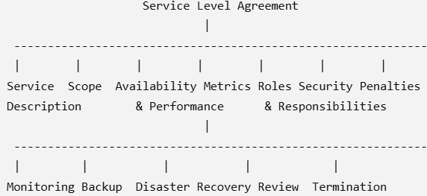
Service Level Agreement Contents
Diagram of SLA Contents

Slide 57
Service Level Agreement Contents
1. Service Description
Definition: This section explains what services are being provided by the cloud service provider.
It clearly defines: Type of cloud service,Features,Service duration,Service location
Example:
Amazon Web Services provides:
EC2 Virtual Machines,S3 Storage,RDS Database,Cloud Networking
Importance
Eliminates confusion
Clearly defines customer expectations
Identifies the services covered under the SLA

Slide 58
Service Level Agreement Contents
2. Scope of Services
The scope defines which services are included and excluded in the agreement.
Includes: Compute services,Storage services,Networking,Database services,Technical support
Excludes:Third-party software,Customer-managed hardware,Internet connection issues,Customer configuration errors
Example
AWS provides cloud servers but does not guarantee the customer's local internet connection.

Slide 59
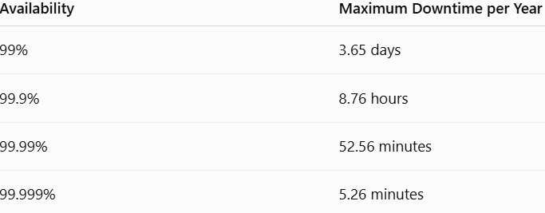

Service Level Agreement Contents
3. Service Availability
Availability specifies how often the service should remain operational.
It is usually expressed as a percentage.
Common Availability Levels:
Formula:
Example: AWS EC2 guarantees 99.99% availability.

Slide 60
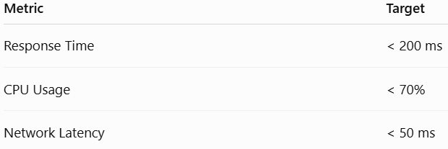
Service Level Agreement Contents
4. Performance Metrics
Performance metrics measure the quality of cloud services.
Common metrics include: Response Time,Throughput,Latency,CPU Utilization,Memory Usage
Network Speed,Packet Loss
Example
Importance: Measures service quality
Helps monitor provider performance
Supports SLA compliance

Slide 61
Service Level Agreement Contents
5. Roles and Responsibilities
An SLA clearly defines the responsibilities of both the provider and the customer.
Cloud Provider Responsibilities:
Maintain infrastructure
Provide agreed availability
Perform backups
Ensure security
Monitor services
Resolve incidents
Customer Responsibilities:Pay subscription fees,Manage user accounts,Follow security guidelines,Report problems,Use services according to the agreement

Slide 62
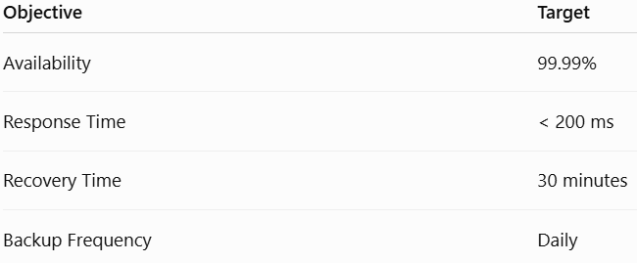
Service Level Agreement Contents
6. Service Level Objectives (SLOs)
SLOs are specific performance targets agreed upon in the SLA.
Examples:
Importance:
Defines measurable goals
Helps evaluate service performance

Slide 63
Service Level Agreement Contents
7. Monitoring and Reporting
Cloud providers continuously monitor their services.
Monitoring includes:CPU usage,Memory utilization,Disk usage,Network traffic,Service uptime,Error logs
Reports may include:
Monthly uptime reports,Performance reports,Security reports,Billing reports
Example
AWS CloudWatch monitors resource usage and generates performance reports.

Slide 64
Service Level Agreement Contents
8. Security and Compliance
This section explains how customer data will be protected.
Security measures include: Data encryption,Identity and Access Management (IAM),Firewalls,Multi-Factor Authentication (MFA)
Network Security,Regular Security Audits
Compliance Standards:
ISO 27001
GDPR
HIPAA
PCI DSS
Example
Google Cloud encrypts customer data both at rest and in transit.

Slide 65
Service Level Agreement Contents
9. Backup and Disaster Recovery
Cloud providers define how customer data will be protected during failures.
Backup includes:Daily backup,Weekly backup,Incremental backup,Full backup
Disaster recovery includes:Data restoration,Server recovery,Failover systems,Replication
Example
Azure automatically replicates storage across multiple regions..

Slide 66
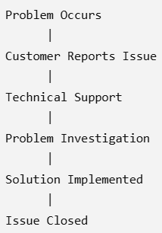
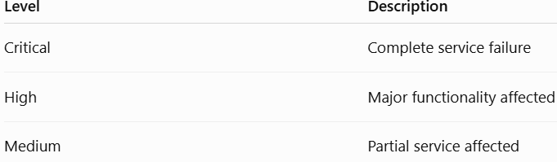
Service Level Agreement Contents
10. Incident and Problem Management
This section explains how service failures are handled.
Typical process:
Severity Levels :

Slide 67
Service Level Agreement Contents
11. Change Management
Cloud providers regularly update their infrastructure.
Changes may include:
Software upgrades
Hardware replacement
Security patches
Feature additions
Customers are informed before planned maintenance.

Slide 68
Service Level Agreement Contents
12. SLA Violations and Penalties
If the provider fails to meet SLA requirements:
Customer receives service credits
Refunds may be issued
Penalties are applied
Example
If AWS guarantees 99.99% availability but delivers 99.8%, customers receive service credits according to the SLA.

Slide 69
Service Level Agreement Contents
13. Exclusions
Some situations are not covered under the SLA.
Examples:
Natural disasters
Internet failures at the customer's location
Customer configuration errors
Cyberattacks caused by customer negligence

Slide 70
Service Level Agreement Contents
14. Review and Revision
Business requirements change over time.
Therefore, SLAs are reviewed:
Monthly
Quarterly
Annually
The agreement can be updated based on new requirements.

Slide 71
Service Level Agreement Contents
15. Termination Clause
This section specifies:
When the agreement ends
Notice period
Data migration process
Data deletion policy
Final billing

Slide 72
Service Level Agreement Contents
Advantages of Well-Defined SLA Contents:
Clear expectations for both parties
Improved service quality
Better performance monitoring
Increased customer trust
Faster issue resolution
Legal protection
Reduced disputes
Disadvantages:
Time-consuming to prepare
Complex legal language
Difficult to monitor every metric
Requires periodic updates
May not cover every possible situation

Slide 73
Service Level Agreement Contents
Real-World Example (AWS EC2 SLA)
Suppose a company hosts its website on Amazon EC2. The SLA includes:
Service: Virtual servers (EC2)
Availability: 99.99%
Response Time: Less than 200 ms
Support: 24×7 technical support
Backup: Daily snapshots
Security: IAM, encryption, firewall
Penalty: Service credits if availability drops below the agreed level
Monitoring: Amazon CloudWatch

Slide 74
Types of Service Level Agreement (SLA)
Types of Service Level Agreement (SLA)
An SLA (Service Level Agreement) is a formal contract between a cloud service provider and a customer that defines the expected level of service.
However, not all customers require the same type of agreement. Different cloud services have different requirements, leading to different types of SLAs.
Types of SLA refer to different ways of structuring a Service Level Agreement based on the customer, service, or organizational hierarchy.
A Service Level Agreement (SLA) can be designed differently depending on the type of customer and the services offered. Organizations may require different agreements for different services or departments. Therefore, SLAs are classified into three main types.

Slide 75
Types of Service Level Agreement (SLA)
Types of SLA
An SLA can be classified into three main types:
Customer-Based SLA
Service-Based SLA
Multi-Level SLA

Slide 76
Types of Service Level Agreement (SLA)
Types of SLA
1. Customer-Based SLA
A Customer-Based SLA is an agreement made with a single customer covering all the services that customer uses.
It is customized according to the customer's business needs.
Example
A university signs one SLA with AWS for:
Virtual Machines
Storage
Database
Email Service
All these services are covered under one agreement.

Slide 77
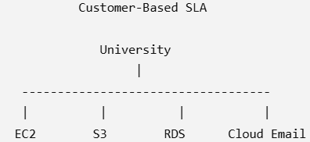
Types of Service Level Agreement (SLA)
Types of SLA
Diagram:
Advantages:
Easy to manage
Customized for customer
Single agreement
Disadvantages:
Difficult to update individual services
Not reusable for other customers

Slide 78
Types of Service Level Agreement (SLA)
Types of SLA
2. Service-Based SLA
A Service-Based SLA applies to a single cloud service that is offered to all customers.
Every customer using that service receives the same SLA.
Example
AWS EC2 provides:
99.99% Availability
24×7 Support
Every EC2 customer receives the same SLA.

Slide 79
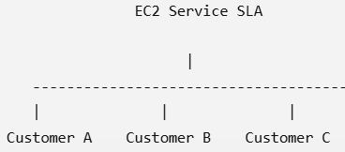
Types of Service Level Agreement (SLA)
Types of SLA
Diagram:
Advantages
Easy to maintain
Standardized agreement
Same quality for everyone
Disadvantages
Cannot be customized
May not satisfy every customer

Slide 80
Types of Service Level Agreement (SLA)
3. Multi-Level SLA
A Multi-Level SLA divides the agreement into multiple levels based on the organization.
Levels include:
Corporate Level
Customer Level
Service Level
Corporate Level
Applies to all customers of the organization.
Examples:
Security policy
Data privacy
Compliance requirements
Support policy

Slide 81
Types of Service Level Agreement (SLA)
3. Multi-Level SLA
Customer Level
Covers the requirements of a particular customer or customer group.
Examples:
Response time
Backup schedule
Recovery objectives
Service Level
Defines the performance requirements for a specific service.
Examples:
Storage availability
Database uptime
VM performance

Slide 82
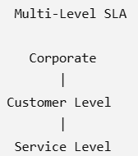
Types of Service Level Agreement (SLA)
3. Multi-Level SLA
Diagram
Advantages
Highly flexible
Easy to customize
Better management
Disadvantages
Complex
Difficult to administer

Slide 83
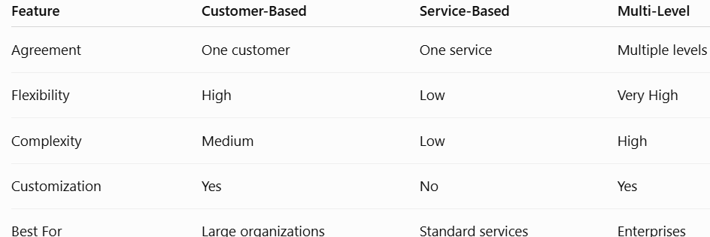
Types of Service Level Agreement (SLA)
Comparison of SLA Types
Example:
SLA: "The provider guarantees high availability."
SLO: "Availability will be at least 99.95%."
KPI: "Measured monthly uptime was 99.97%."

Slide 84
Service Level Objectives (SLOs)
Service Level Objectives (SLOs)
Introduction
The SLA defines the overall agreement, while Service Level Objectives (SLOs) define the specific measurable targets that the provider must achieve.
Definition
A Service Level Objective (SLO) is a measurable performance target that specifies the expected quality of a cloud service.

Slide 85
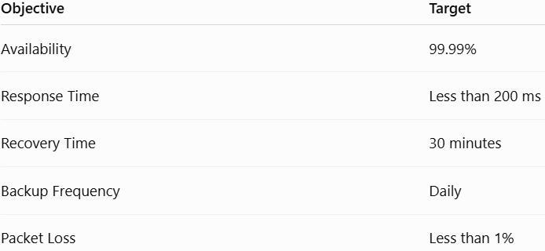
Service Level Objectives (SLOs)
Examples of SLOs:
Characteristics:
Measurable
Realistic
Time-bound
Customer-focused
Performance-oriented

Slide 86
Service Level Objectives (SLOs)
Importance:
Measures service quality
Helps monitor provider performance
Improves customer satisfaction
Supports SLA compliance
Example: Google Cloud Storage
SLO
Availability = 99.95%
If availability drops below this value, the provider may owe service credits.
Advantages: Easy performance measurement,
Better monitoring,
Improved transparency

Slide 87
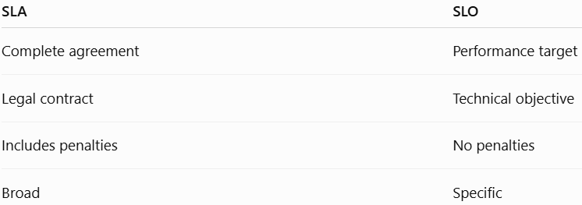
Service Level Objectives (SLOs)
Difference between SLA and SLO

Slide 88
SLA Requirements
SLA Requirements
Introduction
For an SLA to be effective, it should clearly specify the quality of service expected from the cloud provider.
These expectations are called SLA Requirements.
Major SLA Requirements
1. Availability
Cloud services should remain available according to the agreed uptime.
Example:
99.99%

Slide 89
SLA Requirements
SLA Requirements
2. Reliability
The system should operate without frequent failures.
3. Scalability
The provider should increase or decrease resources based on demand.
4. Performance
Services should provide:
Fast response time
Low latency
High throughput

Slide 90
SLA Requirements
SLA Requirements
5. Security
Includes:
Encryption
Authentication
Firewalls
Access Control
6. Backup
Regular backups should be performed.
7. Disaster Recovery
Services should recover quickly after failures.

Slide 91
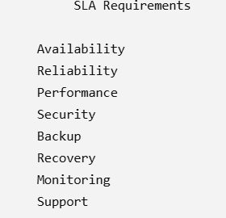
SLA Requirements
SLA Requirements
8. Technical Support
Support should be available according to SLA.
Example:
24×7 Help Desk
9. Monitoring
Continuous monitoring of services.

Slide 92
SLA Requirements
Functional Requirements
These describe what services the cloud provider must deliver.
Common Functional Requirements
Compute services (Virtual Machines)
Storage services
Network connectivity
Backup and recovery
Load balancing
Auto scaling
Database services
Authentication and authorization

Slide 93
SLA Requirements
Non-Functional Requirements
These describe how well the services must perform.
Common Non-Functional Requirements
Availability
Reliability
Scalability
Performance
Security
Privacy
Compliance (e.g., GDPR, HIPAA, ISO 27001)
Response time
Recovery time
Monitoring
Disaster recovery

Slide 94
SLA Requirements
Functional vs Non-Functional Requirements
Functional Requirements Non-Functional Requirements
Virtual Machines Availability
Storage Performance
Networking Reliability
Backup Scalability
Authentication Security
Database Services Compliance

Slide 95
SLA Requirements
Classroom Activity
Scenario: A hospital wants to move its patient management system to the cloud.
identify:
Which type of SLA is most suitable?
Suggest three SLOs for the service.
List five functional requirements.
List five non-functional requirements.

Slide 96
SLA Requirements
Classroom Activity
Scenario: A hospital wants to move its patient management system to the cloud.
Possible Answers:
SLA Type: Customer-Based SLA (because the hospital has specific security and availability needs).
SLOs: 99.99% availability, incident response within 30 minutes, daily encrypted backups.
Functional Requirements: Virtual machines, database, storage, backup, authentication.
Non-Functional Requirements: Security, privacy, reliability, performance, compliance.

Slide 97
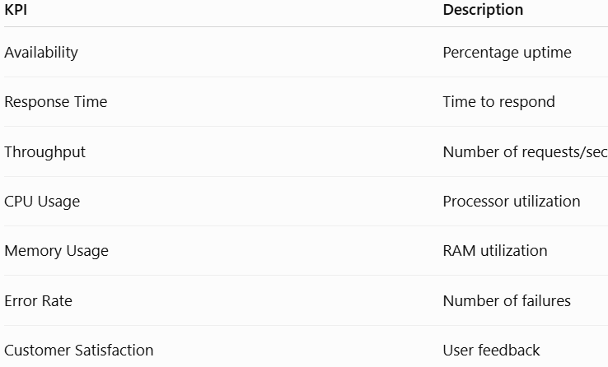
Key Performance Indicators (KPIs)
Key Performance Indicators (KPIs)
A Key Performance Indicator (KPI) is a measurable value used to evaluate whether cloud services are meeting business and technical objectives.

Slide 98
Key Performance Indicators (KPIs)
Why KPIs are Important:
Measure service quality
Detect performance degradation
Improve customer satisfaction
Reduce downtime
Support SLA compliance
Improve decision making
Enable proactive maintenance

Slide 99
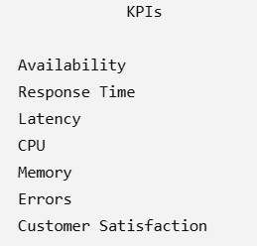
Key Performance Indicators (KPIs)
Example: A website receives:1000 requests/sec
Response Time 180 milliseconds
These values are KPIs.

Slide 100
Key Performance Indicators (KPIs)
Characteristics of a Good KPI
A KPI should be
Specific
Measurable
Achievable
Relevant
Time-bound (SMART)
Example
Poor KPI
"System should be fast."
Good KPI
"Average response time should be less than 150 milliseconds."

Slide 101


Key Performance Indicators (KPIs)
Cloud Performance Metrics
Cloud providers monitor several performance metrics continuously.
A. Availability
Availability measures the percentage of time a cloud service is operational.
Formula
Example
One month = 43,200 minutes,Downtime = 30 minutes
Availability
High availability means: fewer outages
better customer experience
improved reliability

Slide 102
Key Performance Indicators (KPIs)
Common Cloud Performance Metrics
B. Response Time
Response time is Time taken by the server to respond after receiving a request.
Example:
Customer requests a webpage.
Request received:
10:00:00
Response sent:
10:00:00.150
Response Time
150 milliseconds
Ideal Values: Website< 200 ms
Database <100 ms
Critical applications<50 ms

Slide 103
Key Performance Indicators (KPIs)
Common Cloud Performance Metrics
C. Latency
Latency is Delay experienced while transmitting data over the network.
Causes
Long network distance(The farther the data has to travel, the longer it takes to reach the destination.)
Network Congestion(When many users send data simultaneously, network devices such as routers and switches become overloaded)
Routing delays(data passes through several intermediate devices called routers.)
Hardware limitations(Older or overloaded hardware)
Example
Mumbai → Singapore
Latency 40 ms
Lower latency means faster communication.

Slide 104
Key Performance Indicators (KPIs)
Common Cloud Performance Metrics
D. Throughput
Throughput measures Amount of data processed per unit time.
Units
Mbps
Gbps
Transactions/sec
Example
Network transfers 5 GB
Time 50 seconds
Throughput 100 MB/sec
Better performance
Higher processing capacity

Slide 105

Key Performance Indicators (KPIs)
Common Cloud Performance Metrics
E. Error Rate
Error rate indicates Percentage of failed requests.
Formula
Example
Requests 20,000
Failed 40
Error Rate 0.2%

Slide 106
Key Performance Indicators (KPIs)
Common Cloud Performance Metrics
F. Resource Utilization
Measures usage of cloud resources.
CPU utilization
Memory utilization
Disk utilization
Network utilization
Example
CPU Usage 65%
Memory Usage 72%
Disk Usage 40%
Avoids: Overloading,Under-utilization,Performance bottlenecks

Slide 107
Key Performance Indicators (KPIs)
Common Cloud Performance Metrics
G. Reliability
Reliability measures
Ability of a system to operate continuously without failure.
Measured using
MTBF (Mean Time Between Failures)
Failure Rate
Higher reliability
→ Better SLA compliance

Slide 108
Key Performance Indicators (KPIs)
Common Cloud Performance Metrics
H. Scalability
Scalability measures Ability to handle increasing workloads.
Example
Website traffic increases
10,000 users
↓
100,000 users
Cloud automatically adds servers.

Slide 109
Key Performance Indicators (KPIs)
Common Cloud Performance Metrics
I. Network Bandwidth
Bandwidth is Maximum amount of data that can be transmitted.
Units:Mbps,Gbps
Higher bandwidth: Higher data transfer capacity

Slide 110
Key Performance Indicators (KPIs)
Common Cloud Performance Metrics
J. Customer Satisfaction
Cloud providers also monitor
Customer feedback
SLA complaints
Support ticket resolution
Net Promoter Score (NPS)
Customer Satisfaction Score (CSAT)
These indicators reflect the user’s experience and help identify areas for service improvement.

Slide 111
Monitoring and Auditing Metrics
What is Monitoring?
Monitoring is the continuous observation of cloud infrastructure, applications, and services to ensure they perform according to the SLA.
Objectives
Detect failures early
Monitor resource usage
Improve availability
Prevent SLA violations
Optimize performance
Generate alerts for abnormal behavior

Slide 112
Monitoring and Auditing Metrics
Types of Monitoring
Infrastructure Monitoring
CPU
RAM
Disk
Virtual Machines
Network devices
2. Application Monitoring
Application response time
Error logs
User transactions
API performance

Slide 113
Monitoring and Auditing Metrics
Types of Monitoring
3. Network Monitoring
Bandwidth
Packet loss
Latency
Traffic flow
4. Security Monitoring
Login attempts
Unauthorized access
Malware detection
Firewall events

Slide 114
Monitoring and Auditing Metrics
Monitoring Process:
Collect metrics from cloud resources.
Analyze the collected data.
Compare values with SLA thresholds.
Trigger alerts if thresholds are exceeded.
Generate reports and dashboards.
Take corrective actions if necessary.

Slide 115
Monitoring and Auditing Metrics
Popular Cloud Monitoring Tools
Amazon CloudWatch (AWS)
Azure Monitor (Microsoft Azure)
Google Cloud Monitoring (Google Cloud Platform)
Prometheus
Grafana
Nagios
Zabbix

Slide 116
Monitoring and Auditing Metrics
Auditing in Cloud Computing
What is Auditing?
Auditing is the systematic examination of cloud services, configurations, logs, and security controls to verify compliance with organizational policies, legal regulations, and SLA commitments.
Objectives of Auditing:
Verify SLA compliance
Ensure regulatory compliance
Detect security vulnerabilities
Identify unauthorized activities
Improve accountability

Slide 117
Monitoring and Auditing Metrics
Types of Audits
Internal Audit
Conducted by the organization to evaluate internal controls and operational effectiveness.
2. External Audit
Performed by independent auditors or certification bodies to ensure compliance with standards and regulations.
3. Security Audit
Evaluates security controls, authentication mechanisms, encryption, firewall configurations, and access management.
4. Compliance Audit
Checks adherence to standards and regulations such as ISO 27001, GDPR, HIPAA, or PCI-DSS.

Slide 118
Monitoring and Auditing Metrics
Audit Logs
Audit logs record system activities such as:
User logins and logouts
Configuration changes
File access
Resource provisioning
Failed authentication attempts
Administrative actions
These logs are essential for troubleshooting, forensic investigations, and demonstrating compliance.

Slide 119
Monitoring and Auditing Metrics
Case Study: Amazon EC2 Monitoring
Suppose AWS promises:
Availability = 99.99%
CPU utilization < 80%
Response time < 200 ms
During monitoring:
Availability = 99.95%
CPU = 92%
Response Time = 320 ms

Slide 120
Monitoring and Auditing Metrics
Case Study: Amazon EC2 Monitoring
Observations:
Availability is below the SLA target.
CPU utilization is excessively high.
Response time exceeds the SLA threshold.
Conclusion: The service is not meeting the agreed SLA and corrective actions such as auto-scaling, load balancing, or infrastructure optimization are required.

Slide 121
SLA Requirements with Cloud Delivery Models
A Service Level Agreement (SLA) specifies the level of service that a cloud provider guarantees to its customers. However, the SLA differs depending on the cloud service model because the responsibilities of the provider and customer change.
The three main cloud delivery models are:
Infrastructure as a Service (IaaS)
Platform as a Service (PaaS)
Software as a Service (SaaS)
Each model has different SLA requirements.

Slide 122
SLA Requirements with Cloud Delivery Models
Different cloud service models require different SLA requirements.
1. Infrastructure as a Service (IaaS):The provider supplies virtualized infrastructure, while the customer manages the operating system, applications, and data.
Examples:
AWS EC2
Azure Virtual Machines
Google Compute Engine
SLA Requirements:
VM Availability
Storage Availability
Network Performance
Backup
Disaster Recovery
Example:WS guarantees 99.99% EC2 uptime.

Slide 123
SLA Requirements with Cloud Delivery Models
2. Platform as a Service (PaaS):The provider manages the infrastructure and platform, while the customer develops and deploys applications.
Examples:
Google App Engine
Azure App Service
AWS Elastic Beanstalk
SLA Requirements:
Platform Availability
Runtime Performance
Database Services
API Availability
Auto Scaling
Example: Google App Engine guarantees high platform availability and automatic scaling.

Slide 124
SLA Requirements with Cloud Delivery Models
2. Platform as a Service (PaaS):The provider manages the infrastructure and platform, while the customer develops and deploys applications.
Examples:
Google App Engine
Azure App Service
AWS Elastic Beanstalk
SLA Requirements:
Platform Availability
Runtime Performance
Database Services
API Availability
Auto Scaling
Example: Google App Engine guarantees high platform availability and automatic scaling.

Slide 125
SLA Requirements with Cloud Delivery Models
3. Software as a Service (SaaS)
The provider manages the entire application stack, and the customer simply uses the software.
Examples: Gmail,Microsoft 365,Salesforce

Slide 126
SLA Requirements with Cloud Delivery Models
SLA Requirements for IaaS
In IaaS, the cloud provider offers virtualized computing resources such as virtual machines, storage, and networking.
The SLA focuses on ensuring the availability and performance of these infrastructure components.
SLA Requirements
1. Compute Availability
The provider guarantees VM uptime.
Example:
99.95% Virtual Machine Availability

Slide 127
SLA Requirements with Cloud Delivery Models
SLA Requirements for IaaS
2. Storage Availability
Storage should remain accessible.
Requirements include:
High durability
Data redundancy
Fast access
3. Network Availability
The provider guarantees:
Internet connectivity
Internal network communication
Load balancing

Slide 128
SLA Requirements with Cloud Delivery Models
SLA Requirements for IaaS
4. Backup and Disaster Recovery
The SLA should specify:
Backup frequency
Data restoration process
Recovery Time Objective (RTO)
Recovery Point Objective (RPO)
5. Performance
Performance metrics include:
CPU allocation
Memory allocation
Disk I/O
Network bandwidth

Slide 129
SLA Requirements with Cloud Delivery Models
SLA Requirements for IaaS
6. Security
Infrastructure security should include:
Firewall protection
Identity and Access Management (IAM)
Encryption
DDoS protection

Slide 130
SLA Requirements with Cloud Delivery Models
SLA Requirements for IaaS
Example IaaS SLA
SLA Parameter Example
VM Availability 99.95%
Storage Availability 99.99%
Network Availability 99.9%
Backup Daily
RTO 2 Hours
RPO 30 Minutes

Slide 131
SLA Requirements with Cloud Delivery Models
SLA Requirements for PaaS
PaaS provides an application development platform where developers focus on writing code while the provider manages the infrastructure.
SLA Requirements
1. Platform Availability
The development platform should always be accessible.
Example:
Runtime availability of 99.95%

Slide 132
SLA Requirements with Cloud Delivery Models
SLA Requirements for PaaS
2. Database Availability
The managed database service should be highly available.
Example:
Database uptime of 99.99%
3. API Availability
APIs should be continuously accessible.
Example:
API uptime of 99.9%

Slide 133
SLA Requirements with Cloud Delivery Models
SLA Requirements for PaaS
4. Runtime Environment
The provider maintains:
Java
Python
Node.js
.NET
PHP
5. Automatic Scaling
Applications should automatically scale based on demand.

Slide 134
SLA Requirements with Cloud Delivery Models
SLA Requirements for PaaS
6. Development Tools
The provider should support:
Continuous Integration (CI)
Continuous Deployment (CD)
Source control integration
Monitoring tools

Slide 135
SLA Requirements with Cloud Delivery Models
Example PaaS SLA
SLA Parameter Example
Platform Availability 99.95%
Database Availability 99.99%
API Response Time Less than 200 ms
Auto Scaling Enabled
Deployment Support 24×7

Slide 136
SLA Requirements with Cloud Delivery Models
SLA Requirements for SaaS
In SaaS, users access ready-to-use software over the internet.
The provider manages everything from infrastructure to application updates.
SLA Requirements
1. Application Availability
The software should be available whenever users need it.
Example:
99.9% application uptime.

Slide 137
SLA Requirements with Cloud Delivery Models
SLA Requirements for SaaS
2. User Authentication
Support for secure login using:
Username and password
Multi-Factor Authentication (MFA)
Single Sign-On (SSO)
3. Data Privacy
The provider should protect user data through:
Encryption
Access control
Privacy policies

Slide 138
SLA Requirements with Cloud Delivery Models
SLA Requirements for SaaS
4. Data Backup
Regular backups and clear recovery procedures.
5. Performance
The SLA may specify:
Page load time
Transaction response time
Maximum number of concurrent users
6. Customer Support
Support commitments include:
24×7 technical support
Email support
Live chat
Phone support

Slide 139
SLA Requirements with Cloud Delivery Models
SLA Requirements for SaaS
Example SaaS SLA
SLA Parameter Example
Application Availability 99.9%
Login Response Time Less than 2 seconds
Backup Frequency Daily
Customer Support 24×7
Data Encryption AES-256
MFA Supported

Slide 140
SLA Requirements with Cloud Delivery Models
Comparison of SLA Requirements
Requirement IaaS PaaS SaaS
Virtual Machine Availability ✓ ✗ ✗
Storage Availability ✓ ✓ ✓
Network Availability ✓ ✓ ✓
Runtime Environment Customer Provider Provider
Application Availability Customer Shared Provider
Database Availability Customer-managedProvide Provider
Automatic Scaling Optional Usually Included Provider
Security Shared Responsibility Shared Responsibility Mostly Provider
Backup Shared Responsibility Provider Provider
Technical Support Infrastructure Platform Complete Application

Slide 141
SLA Requirements with Cloud Delivery Models
Shared Responsibility Model
The responsibility for managing resources changes depending on the cloud service model.
Component On-Premises IaaS PaaS SaaS
Applications Customer Customer Customer Provider
Data Customer Customer Customer Shared
Runtime Customer Customer Provider Provider
Middleware Customer Customer Provider Provider
Operating System Customer Customer Provider Provider
Virtualization Customer Provider Provider Provider
Servers Customer Provider Provider Provider
Storage Customer Provider Provider Provider
Networking Customer Provider Provider Provider
As you move from IaaS → PaaS → SaaS, the cloud provider assumes more responsibility, reducing the management burden on the customer.

Slide 142
SLA Requirements with Cloud Delivery Models
Real-World Examples
Amazon EC2 (IaaS)
Guarantees VM availability through its SLA.
Provides virtual machines, storage, and networking.
Customers are responsible for configuring the operating system and applications.
Google App Engine (PaaS)
Automatically scales applications.
Manages infrastructure and runtime.
Developers focus on application code.
Microsoft 365 (SaaS)
Provides email, collaboration, and office applications.
Users access software through a web browser or desktop client.
Microsoft handles updates, backups, and infrastructure.

Slide 143
Examples of Cloud SLAs
Introduction
Cloud Service Providers (CSPs) like Amazon Web Services (AWS), Microsoft Azure, and Google Cloud Platform (GCP) provide Service Level Agreements (SLAs) to assure customers of service quality. These SLAs specify commitments such as uptime, support, and compensation if the service does not meet agreed standards.
Definition
A Cloud SLA is a formal agreement between a cloud provider and a customer that defines guaranteed service levels, including availability, performance, support, and penalties.

Slide 144
Examples of Cloud SLAs
Why Study Cloud SLAs?
Different cloud providers offer different levels of service.
Organizations compare SLAs before selecting a cloud provider because SLAs directly affect:
Business continuity
Customer satisfaction
Downtime
Financial loss
Compliance requirements

Slide 145
Examples of Cloud SLAs
Example 1: Amazon Web Services (AWS) SLA
AWS offers SLAs for services such as:
EC2 (Virtual Machines)
S3 (Storage)
RDS (Database)
DynamoDB
Lambda
EC2 SLA

Slide 146
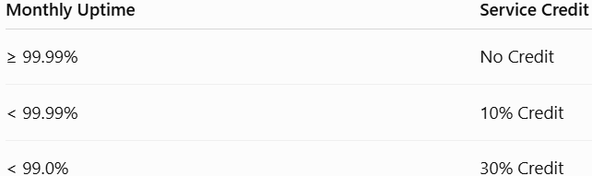
Examples of Cloud SLAs
Example 1: Amazon Web Services (AWS) SLA
AWS guarantees:
Monthly Uptime Percentage (MUP): 99.99%
If uptime falls below this value, customers receive service credits.
Example:

Slide 147
Examples of Cloud SLAs
Example 2: Microsoft Azure SLA
Azure provides SLAs for:
Virtual Machines
Azure SQL Database
Azure Storage
Azure App Services
Example:
Azure Virtual Machines guarantee up to 99.99% availability (depending on deployment configuration).
Features:
Automatic failover
Backup
Monitoring
High Availability

Slide 148
Examples of Cloud SLAs
Example 3: Google Cloud SLA
Google Cloud provides SLAs for:
Compute Engine
Cloud Storage
BigQuery
GKE (Google Kubernetes Engine)
Example:
Google Compute Engine guarantees 99.95% or higher availability, depending on deployment.
Features:
Live Migration
Global Load Balancing
Auto Scaling

Slide 149
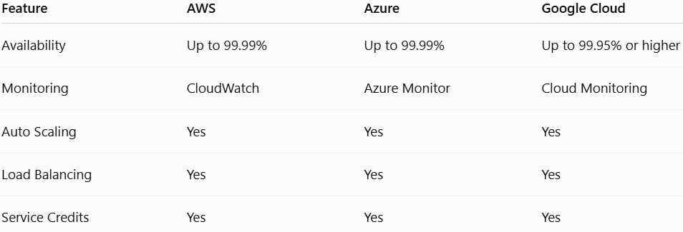
Examples of Cloud SLAs
Comparison of Cloud SLAs

Slide 150
Examples of Cloud SLAs
Advantages:
High availability
Transparent performance guarantees
Compensation for failures
Increased customer trust
Real-Life Example
An online shopping company hosts its application on AWS.
SLA:
Availability = 99.99%
Response Time = 200 ms
Backup = Daily
If AWS fails to meet the uptime target, the company receives service credits.

Slide 151
Limitations of SLA
Introduction
Although SLAs improve service quality and accountability, they also have several limitations.
Definition
Limitations of SLA are the drawbacks or restrictions that reduce the effectiveness of a Service Level Agreement.
Major Limitations
1. Difficult to Measure
Some performance metrics (such as user experience) are difficult to quantify accurately.

Slide 152
Limitations of SLA
2. Complex Agreements
Large organizations often have lengthy SLAs with technical and legal language that can be difficult to understand.
3. Service Credits Instead of Cash
Most cloud providers compensate customers with service credits, not cash refunds.
4. Exclusions
SLAs usually exclude events such as:
Natural disasters
War
Internet failures outside the provider's control
Customer configuration errors

Slide 153
Limitations of SLA
5. No Guarantee Against All Downtime
Even with a 99.99% SLA, some downtime is still allowed.
6. Monitoring Challenges
Customers need monitoring tools to verify whether the provider meets SLA commitments.
7. Vendor Dependency
Each cloud provider defines its own SLA terms, making comparisons difficult.

Slide 154
Limitations of SLA
Advantages Despite Limitations
Defines responsibilities
Improves service quality
Encourages transparency
Builds trust

Slide 155
Numericals on Service Availability
What is Service Availability?
Service Availability is the percentage of time that a cloud service is operational and accessible to users during a specified period.
It is one of the most important metrics specified in a Service Level Agreement (SLA).
Service Availability is the probability or percentage that a cloud service remains operational and accessible during the agreed service period.
High availability ensures:
Continuous access to services
Improved customer satisfaction
Reduced business losses
Better reliability
Compliance with SLA commitments

Slide 156
Numericals on Service Availability
Examples
Application Importance of Availability
Internet Banking Very High
Hospital Information System Very High
Cloud Storage High
Email Service High
Social Media Moderate

Slide 157

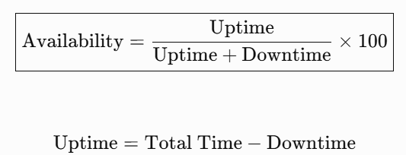
Numericals on Service Availability
Introduction
Service Availability indicates how much time a cloud service remains operational.
It is usually expressed as a percentage.
Formula
Alternate Formula:

Slide 158
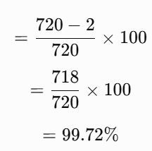
Numericals on Service Availability
Problem
A cloud service operates for 30 days in a month,Downtime = 2 hours.Calculate availability.
Solution:
Total Time
30 × 24 = 720 hours
Availability

Slide 159

Downtime from SLA Availability
Sometimes the SLA availability is given, and you need to calculate the maximum downtime allowed.
Q) An SLA guarantees 99.9% availability.
Calculate the maximum downtime allowed in 30 days.
Solution:

Slide 160
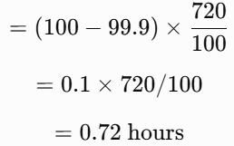
Downtime from SLA Availability
Sometimes the SLA availability is given, and you need to calculate the maximum downtime allowed.
Q) An SLA guarantees 99.9% availability.
Calculate the maximum downtime allowed in 30 days.
Solution:
Total time 30 × 24 = 720 hours
Downtime
0.72 hour × 60 = 43.2 minutes

Slide 161
Downtime from SLA Availability
Q 2) A cloud provider promises 99.99% availability.
Find the maximum downtime allowed in one year.
Solution:

Slide 162
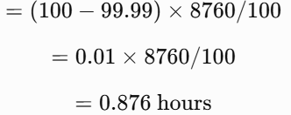
Downtime from SLA Availability
Q 2) A cloud provider promises 99.99% availability.
Find the maximum downtime allowed in one year.
Solution:
Total time 365 × 24 = 8760 hours
Downtime
Convert into minutes
0.876 × 60 = 52.56 minutes

Slide 163
SLA Violation
An SLA violation occurs when the actual service availability is lower than the agreed SLA availability.
Q) The SLA guarantees 99.95% availability.Actual availability achieved = 99.80%.Has the SLA been violated?
Solution:
Guaranteed availability: 99.95%
Actual availability: 99.80%
Since 99.80 < 99.95
Answer: Yes, the SLA has been violated.

Slide 164
SLA Violation
An SLA violation occurs when the actual service availability is lower than the agreed SLA availability.
Q) Guaranteed SLA = 99.5%
Actual Availability = 99.7%
Solution:
99.7 > 99.5
Answer: No SLA violation.

Slide 165

SLA Penalty Computation
Cloud providers often compensate customers if the SLA is violated.
Q) Monthly cloud bill = ₹50,000,SLA violation penalty = 10%
Find the compensation.
Solution:
Penalty =50000×10/100
= ₹5,000

Slide 166
SLA Penalty Computation
Cloud providers often compensate customers if the SLA is violated.
Q) Cloud service cost = ₹80,000, Penalty percentage = 15%
Calculate penalty.
Solution:
Penalty=80000×15/100
= ₹12,000
Answer: ₹12,000

Slide 167
Problems
Q) A company uses cloud services for 30 days.
SLA = 99.9%
Actual downtime = 2 hours
Monthly service charge = ₹1,20,000
Penalty = 20%
Find: Actual availability,SLA violated?,Penalty amount
Solution:

Slide 168
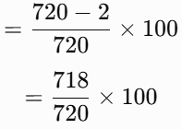
Problems
Q) A company uses cloud services for 30 days.
SLA = 99.9%
Actual downtime = 2 hours
Monthly service charge = ₹1,20,000
Penalty = 20%
Find: Actual availability,SLA violated?,Penalty amount
Solution:
Step 1:Total hours =30 × 24= 720
Step 2: Availability
= 99.72%

Slide 169
Problems
Step 3:
Compare Guaranteed 99.9%
Actual 99.72%
99.72 < 99.9
SLA violated.
Step 4:
Penalty =120000×20/100
= ₹24,000

Slide 170
SLA Credit Calculation
SLA Credit Calculation
Instead of cash, many providers offer service credits.
Q) Monthly bill = ₹15,000
SLA credit = 25%
Find the credit.
Solution:
Credit =15000×25/100
= ₹3,750
Customer receives ₹3,750 as a service credit.

Slide 171
SLA Credit Calculation
Understanding "Number of Nines"
Cloud providers often advertise availability as:
99%
99.9%
99.99%
99.999%
These percentages are commonly referred to as the Number of Nines.
The more nines, the higher the availability and the lower the allowable downtime.

Slide 172
SLA Credit Calculation
Downtime per Year
Availability Maximum Downtime per Year
99% 3.65 days
99.5% 1.83 days
99.9% 8.76 hours
99.95% 4.38 hours
99.99% 52.56 minutes
99.999% 5.26 minutes

Slide 173
SLA Credit Calculation
Downtime per Month (30 Days)
Availability Downtime per Month
99% 7.2 hours
99.5% 3.6 hours
99.9% 43.2 minutes
99.95% 21.6 minutes
99.99% 4.32 minutes
99.999% 25.92 seconds

Slide 174
SLA Credit Calculation
Practical Example
Example: Online Banking System
Suppose an online banking application promises 99.99% availability.
If the application is unavailable for 2 hours in one month:
Allowed downtime: 4.32 minutes
Actual downtime: 120 minutes
Since 120 minutes > 4.32 minutes, the provider has violated the SLA and may owe compensation as specified in the agreement.

Slide 175
Factors Affecting Availability
Factors Affecting Availability
Hardware failures
Software bugs
Network failures
Power outages
Cyberattacks
Scheduled maintenance
Natural disasters
Human errors

Slide 176
Techniques to Improve Availability
Techniques to Improve Availability:
Redundant servers
Load balancing
Data replication
Automatic failover
Regular backups
Disaster recovery plans
Monitoring and alerting
Geographic distribution of data centers

Slide 177
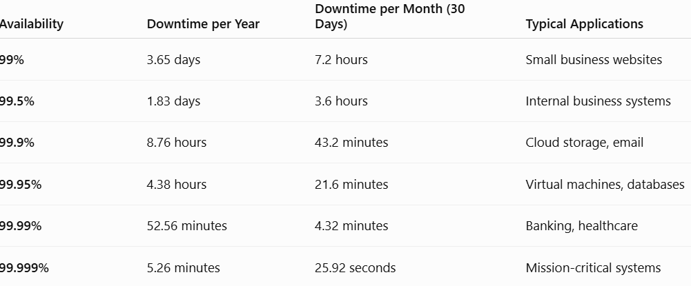
Techniques to Improve Availability

Slide 178
SLA Violation
What is an SLA Violation?
A Service Level Agreement (SLA) violation occurs when a cloud service provider fails to meet one or more service commitments specified in the SLA.
SLA Violation: Failure of the cloud service provider to achieve the agreed Service Level Objectives (SLOs) specified in the SLA.
These commitments may relate to:
Service availability
Response time
Throughput
Latency
Data durability
Recovery time
Customer support response time

Slide 179
SLA Violation
Example
Suppose the SLA guarantees:
Availability = 99.95%
Actual availability during the month:
99.80%
Since the actual availability is lower than the agreed availability, the SLA has been violated.

Slide 180
SLA Violation
Causes of SLA Violations
Several factors can lead to SLA violations.
1. Hardware Failures
Examples:
Server crash
Hard disk failure
Memory failure
Power supply failure
Impact: Increased downtime and reduced availability.

Slide 181
SLA Violation
Causes of SLA Violations
2. Network Failures
Examples:
Internet outage
Router failure
Switch failure
Subsea cable damage
Impact: Users cannot access cloud services.

Slide 182
SLA Violation
Causes of SLA Violations
3. Software Bugs
Examples:
Application crashes
Operating system failures
Database errors
Memory leaks
Impact: Reduced performance and service interruptions.

Slide 183
SLA Violation
Causes of SLA Violations
4. Human Errors
Examples:
Incorrect server configuration
Accidental deletion of data
Wrong firewall settings
Misconfigured virtual machines

Slide 184
SLA Violation
Causes of SLA Violations
5. Cyber Attacks
Examples:
Distributed Denial of Service (DDoS)
Ransomware
Malware
Data breaches
These attacks can make services unavailable or degrade performance.

Slide 185
SLA Violation
Causes of SLA Violations
6. Natural Disasters
Examples:
Floods
Earthquakes
Fires
Storms
Although providers use geographically distributed data centers, severe disasters may still affect service availability.

Slide 186
SLA Violation
SLA Violation Detection
Cloud providers continuously monitor services to detect violations.
Methods of Detection
1. Performance Monitoring
Monitors:
CPU utilization
Memory usage
Network traffic
Disk usage
Tools:
AWS CloudWatch
Azure Monitor
Google Cloud Monitoring

Slide 187
SLA Violation
SLA Violation Detection
Cloud providers continuously monitor services to detect violations.
Methods of Detection
2. Availability Monitoring
Checks whether services are reachable.
Examples:
HTTP monitoring
Ping tests
Health checks

Slide 188
SLA Violation
SLA Violation Detection
Cloud providers continuously monitor services to detect violations.
Methods of Detection
3. Log Analysis
Logs help identify:
System failures
Login attempts
Security incidents
Application errors

Slide 189
SLA Violation
SLA Violation Detection
Cloud providers continuously monitor services to detect violations.
Methods of Detection
4. Alert Systems
Automatic alerts are generated when thresholds are exceeded.
Examples:
Email notifications
SMS alerts
Dashboard warnings

Slide 190
SLA Violation
SLA Violation Detection
Cloud providers continuously monitor services to detect violations.
Methods of Detection
5. Auditing
Regular audits verify compliance with SLA commitments.
Examples:
Security audits
Compliance audits
Performance audits

Slide 191
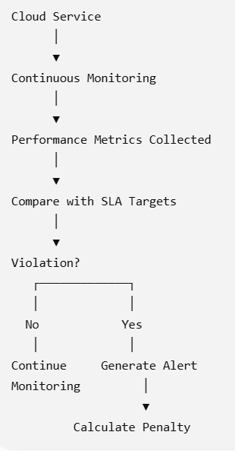
SLA Violation
SLA Violation Detection Process

Slide 192
SLA Violation
Penalty Models in Cloud Computing
When an SLA violation occurs, the provider compensates the customer according to the agreed penalty clause.
1. Service Credit
The provider offers credits that can be used for future cloud services.
Example
Monthly bill = ₹20,000
Penalty = 10%
Service Credit = ₹2,000
The customer receives a ₹2,000 credit for future bills.

Slide 193
SLA Violation
Penalty Models in Cloud Computing
When an SLA violation occurs, the provider compensates the customer according to the agreed penalty clause.
2. Refund
The provider refunds part of the service fee.
Example
Monthly charge = ₹50,000
Penalty = 15%
Refund = ₹7,500

Slide 194
SLA Violation
Penalty Models in Cloud Computing
When an SLA violation occurs, the provider compensates the customer according to the agreed penalty clause.
3. Free Service Extension
The provider extends the subscription period without additional cost.
Example
One month of free cloud storage after an SLA violation

Slide 195
SLA Violation
Penalty Models in Cloud Computing
When an SLA violation occurs, the provider compensates the customer according to the agreed penalty clause.
4. Discount on Future Billing
The provider offers discounts on upcoming invoices.
Example:
20% discount on the next month's bill.

Slide 196

SLA Violation
Penalty Computation Formula
A simple formula often used in academic problems is:
Where:
Monthly Service Cost = Amount paid by the customer
Penalty Percentage = Compensation specified in the SLA

Slide 197
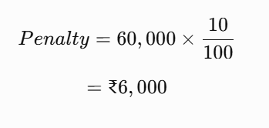
SLA Violation
Problem 1
A company pays ₹60,000 per month for cloud services.The SLA specifies a 10% penalty for an availability violation.Calculate the penalty.
Solution:

Slide 198
SLA Violation
2. A cloud provider guarantees 99.95% availability.
Actual availability is 99.70%.
Has the SLA been violated?
Solution
Guaranteed Availability = 99.95%
Actual Availability = 99.70%
Since
99.70% < 99.95%
Answer: SLA Violated

Slide 199
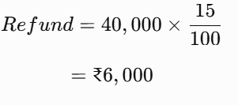
SLA Violation
Problem 3
Monthly subscription = ₹40,000
Penalty = 15%
Calculate the refund.
Solution:

Slide 200
SLA Violation
Problem 4
A cloud provider promises 99.99% availability.During one month (30 days), actual downtime is 30 minutes.Has the SLA been violated?
Solution:
Allowed downtime for 99.99%= 4.32 minutes
Actual downtime= 30 minutes
Since
30 > 4.32
Answer: SLA Violated

Slide 201
SLA Violation
Problem 5
Monthly Bill = ₹80,000
Penalty Policy:
Availability ≥99.95% → No Penalty
Availability 99.90%–99.95% → 10% Credit
Availability <99.90% → 25% Credit
Actual Availability = 99.88%
Solution:
99.88% < 99.90%
Penalty = 25%
80,000×100/25
​=₹20,000

Slide 202
SLA Violation
Best Practices to Avoid SLA Violations
Cloud providers reduce SLA violations by implementing:
High Availability (HA) architectures
Redundant servers
Data replication
Automatic failover
Load balancing
Continuous monitoring
Auto scaling
Disaster recovery plans
Regular backups
Preventive maintenance

